Slide 1
Workshop on Statistics & Probability
Dept of Electronics & communications engg.
Maharaja institute of technology
15, 16 oct 2016

Slide 2
LIMIT THEOREMS

Slide 3
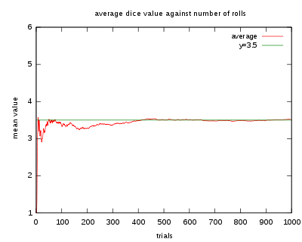
Law of large numbers
It is true that with each coin toss you have a 50/50 chance of getting heads; however, if you toss a coin repeatedly, you cannot be certain that 50% of the tosses will land on heads or vice versa unless you use the law of large numbers. This is because the law of large numbers dictates that as we increase the number of times we toss the coin, we get closer and closer to achieving a 50% probability of getting heads (or 50% for tails!). So, if you have the time to toss a coin thousands of times, you can be pretty sure that just about half of the tosses will land on heads!
Number of Tosses | Number of Heads | Probability of Heads
4 | 1 | 25%
100 | 64 | 64%
1000 | 582 | 58.2%
10000 | 4989 | 49.89%

Slide 4
Law of large numbers(Conti…)
Have you ever seen a contest where there is a jar full of jelly beans along with a prize for the person who guesses how many jelly beans there are inside?
If you try to guess, your answer may not come too close to the total number of jelly beans in the jar. The same may be true if you average the guesses of ten people who give it a try, but what happens if 1,000 people each take a guess and we average their guesses? Interestingly, that average will likely be a lot closer to the actual number of jelly beans in the jar. Which means the probability of guessing the correct amount of jelly beans is higher. As a matter of fact, as the number of guesses increases, the average of the guesses will come closer and closer to the actual number of jelly beans. This is the law of large numbers in action!

Slide 5
BASIC STATISTICS

Slide 6

Standard error(se) $$(σ/√n)$$
The standard error is a measure of dispersion similar to the standard deviation. However, while the standard deviation provides information on the dispersion of sample values, the standard error provides information on the dispersion of values in the sampling distribution associated with the population of interest from which the sample was drawn. Standard error statistics measure how accurate and precise the sample is as an estimate of the population parameter. It is particularly important to use the standard error to estimate an interval about the population parameter when an effect size statistic is not available.
The standard error of the sample mean is an estimate of how far the sample mean is likely to be from the population mean, whereas the standard deviation of the sample is the degree to which individuals within the sample differ from the sample mean.

